Slide 1
Training to Prevent Silicosis
Overview

Slide 2

What is MIOSHA
Michigan Occupational Safety and Health Act (P.A. 154 of 1974, as amended)
Michigan State Program enforces occupational safety and health regulations, required to be as protective as the federal program (OSHA)

Slide 3
Definition “Employer”
"Employer" means an individual or organization, including this state or a political subdivision, that employs 1 or more persons.
If your business is organized as a sole proprietorship or partnership, the owner or partners are not considered employees for recordkeeping purposes.

Slide 4
Definition “Employee”
Employee: “A person permitted to work by an employer”
Definition of an employee includes: employees on your payroll, whether they are labor, executive, hourly, salary, part-time, seasonal, or migrant workers as well as:
  Volunteers
  Students
  Interns
  Temporary help (if you supervise on a day-to-day basis)

Slide 5
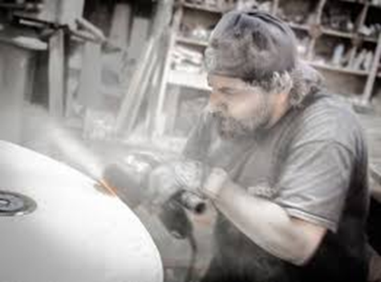
Employer’s Responsibilities
Furnish to each employee, employment and a place of employment, that is free from recognized hazards that are causing, or likely to cause, death or serious physical harm
Comply with standards, regulations and orders issued pursuant to the Act

Slide 6
Employer’s Responsibilities
Post notices and use other appropriate means to keep employees informed of their protections and obligations under this act, including applicable rules and standards
Provide personal protective equipment at employer’s expense when required by a standard

Slide 7
Employer’s Responsibilities
Comply with standards and regulations covered under MIOSHA
Never remove, displace, damage, destroy or carry off a safeguard furnished or provided for use in the workplace
Cannot interfere in any way with the use of a safeguard by another person

Slide 8
Employer Reporting Requirements
Physicians, hospitals, clinics and employers are required by law to report known or suspected cases of occupational disease to the Michigan Department of Licensing and Regulatory Affairs (LARA)

Slide 9
Employer Reporting Requirements
Report to MIOSHA within 24 hours:
  All work-related in-patient hospitalizations
  Amputation (including fingertips)
  Loss of an eye
Report to MIOSHA within 8 hours
  Work-related fatality

Slide 10
Employer Recording Requirements
Work-related injury/illness involving:
  Loss of consciousness
  Restricted work activity or job transfer
  Days away from work
  Medical treatment beyond first aid
  Those diagnosed by a PLHCP
  Those meeting any specific recording criteria listed in Public Law of 1970 and MIOSHA

Slide 11
MIOSHA Forms
MIOSHA Form 300: Log of Work Related Injuries and Illnesses
MIOSHA Form 301: Illness and Injury Report within 7 days when have a recordable injury/illness

Slide 12
MIOSHA Forms
MIOSHA Log 300A – Summary of Work-Related Injuries and Illnesses
  10 employees at any one time during the calendar year immediately before the current calendar year
  Prominently post the 300A annual summary at the worksite from February 1 to April 30 of the year following the year covered by the form

Slide 13
Other Provisions Under MIOSHA
Employer/Employee participation in compliance inspections/investigations
  Inspections: survey to detect presence of hazards and compliance with Act
  Investigations: detailed evaluation of working conditions
Discrimination
Imminent danger

Slide 14
Other Provisions Under MIOSHA
Notification of work-related fatality within 8 hours
Notification within 24 hours of ALL work-related:
  in-patient hospitalizations (1 person or more)
  amputations
  loss of an eye
Recordkeeping
Variances
  Permanent
  Temporary

Slide 15
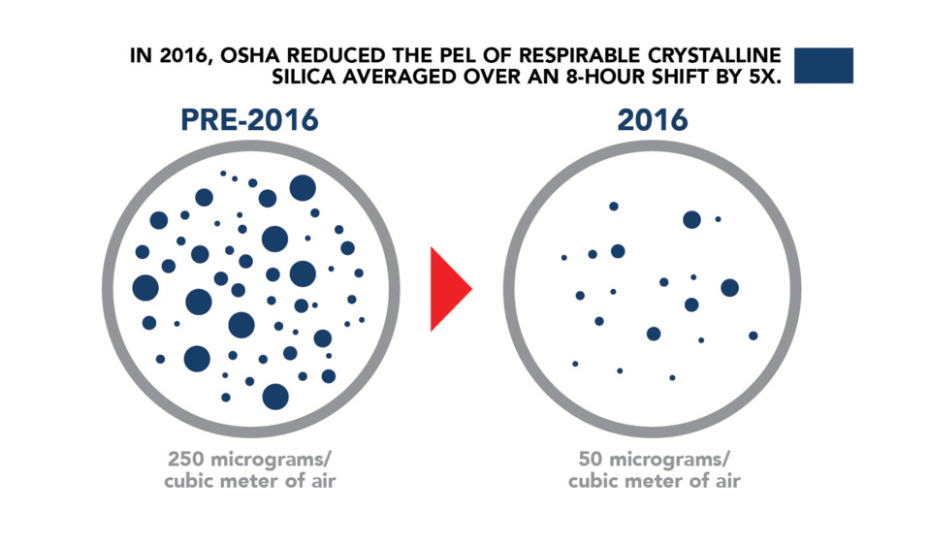
Why You Are Here
https://www.forconstructionpros.com/business/construction-safety/article/20862500/concrete-contractors-must-comply-to-oshas-new-silica-dust-rule-by-september#&gid=1&pid=1

Slide 16
Why You Are Here
MIOSHA General Industry Safety and Health Standard, Part 590 – Silica in General Industry
MIOSHA Construction Safety and Health Standard, Part 690 – Silica in Construction
Questions RE: Which Standard do I fall under??
Call MIOSHA CET

Slide 17
Silica Substitutes
Chapter 1

Slide 18
What is Abrasive Blasting?
Operations where an abrasive is forcibly applied to a surface by pneumatic or hydraulic pressure or by centrifugal force
  Does not apply to steam blasting or steam cleaning or hydraulic-cleaning methods where work is done without the aid of abrasives
Frequently used for:
  cleaning sand from foundry castings
  cleaning and removing paint from metal surfaces
  finishing tombstones
  etching and frosting gl

Slide 19
Silica Substitutes:
Appendix I

Slide 20
Health Hazards of Abrasive Blasting
Chapter 2

Slide 21
Health Hazards of Abrasive Blasting
Silica
Noise
Metals
Other Hazards

Slide 22
What is Silica?
“Crystalline Silica” and “Quartz” refer to the same thing
Major component of sand, rock, granite and mineral ore
Toxic and less/nontoxic forms

Slide 23
Types of Silica
Harmful
Silica, Crystalline (as dust)
Trade Names
Quartz
Cristobalite
Tridymite
Tripoli
Common-Sandblasters
Less Harmful
Silica, Amorphous
Trade Names
Diatomaceous earth
Diatomite
Silica gel
Silicon Dioxide (amorphous)

Slide 24
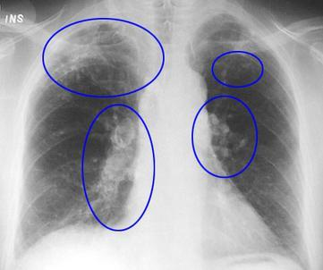
What is Silicosis?
Progressive Lung Disease
  disabling
  non-reversible
  sometimes fatal
  NO CURE
Cause: Inhalation of respirable crystalline silica

Slide 25
Who is at Risk?
Abrasive Blasting
  With silica sand
  On silica-containing substrates
Working without adequate protection
Workers near the blast areas
  Cleaners
  Pot tenders
  Painters
Silicosis is preventable

Slide 26
Why & What We Breathe
Inhalation and Exhalation
  Oxygen/Carbon Dioxide Exchange
  Air & Particulates
Small fraction of inhaled particles are deposited
Remainder are exhaled or removed
Particle size determines what stays in lung

Slide 27
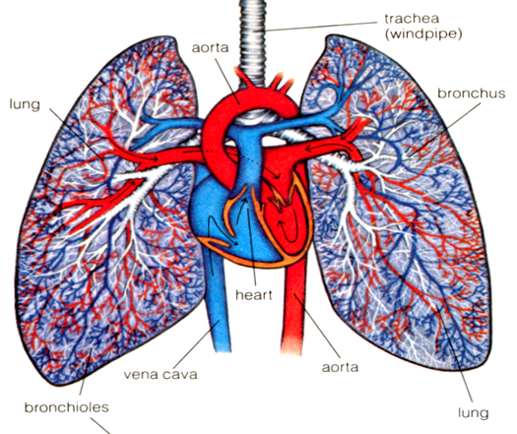
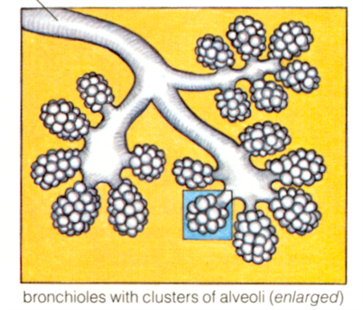
Your Bronchial Tree
Resembles the branches on a tree
Divided into smaller and smaller branches
  Bronchi
  Bronchioles
Business end
  Alveoli

Slide 28
Respirable Dust
Less than 10 microns (µ) in diameter
WHAT’S A MICRON?
  1/24,000 of an inch
Human air
  40-150 µ in diameter
Respirable Silica that causes silicosis:
  0.2-5.0 µ

Slide 29
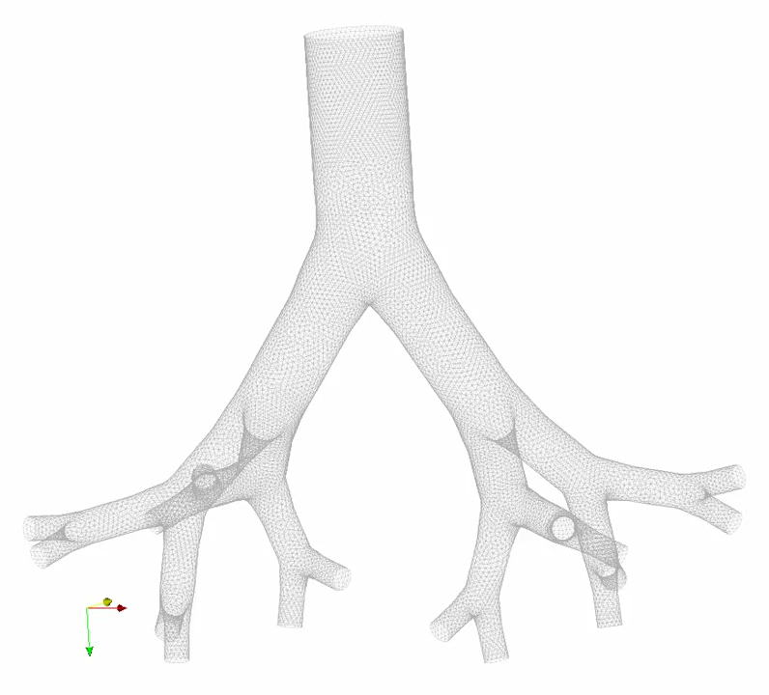
Particle Size Matters

Slide 30
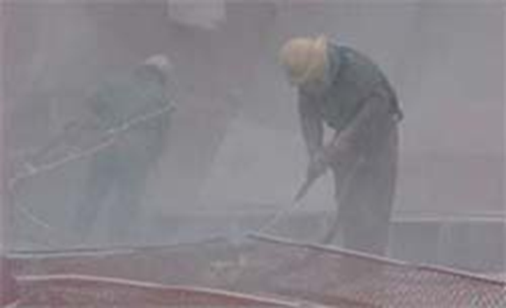
How Does Exposure Occur?
During blasting, silica sand fractures into very fine particles and becomes airborne

Slide 31

Let’s look at how silica enters the lung

Slide 32
What are the Health Effects?
Early stages – may not notice any health effects
As condition worsens, nodules become larger, making breathing more difficult
Lungs can’t get enough oxygen from the air
May be complicated by emphysema (COPD) and/or Tuberculosis

Slide 33

Forms of Silicosis
Acute
Accelerated
Chronic
  Simple
  Complicated

Slide 34
Acute Silicosis
Symptoms develop within a few weeks to months years after initial exposure
Very high exposure concentrations
Fluid accumulations in lung
  Severe shortness of breath
  Low blood oxygen levels

Slide 35
Accelerated Silicosis
Occurs after 3-10 years of exposure
High exposure conditions
Onset of symptoms longer than acute form
Symptoms:
  Severe shortness of breath
  Weakness
  Weight loss
  Form described most often in sandblasters

Slide 36
Chronic Silicosis
Simple Silicosis
15-20 years after exposure
Nodules are small (approx. 1 cm)
Limited scarring
Complicated Silicosis
15-20 years after exposure
Another name: Massive Pulmonary Fibrosis
Nodules in lungs increase in size and grow together encompassing blood vessels and airways

Slide 37
Symptoms
Dry, productive cough
Breathlessness
Loss of appetite
Pain in chest
Malaise
Weight loss
Fatigue
Advanced Disease:
Chronic Obstructive Pulmonary Disease (COPD)
Tuberculosis
Respiratory failure
Congestive heart failure

Slide 38
Tuberculosis (TB)
Silica affects the cells that control TB infection (macrophages)
People with silica exposure are more likely to get TB infections
Symptoms:
  Coughing
  Coughing up blood
  Fever
  Shortness of breath
  Loss of appetite

Slide 39
Silica and Other Disease
Respirable crystalline silica has been classified as a Group 1 “known human carcinogen”
  LUNG CANCER
Silica exposure linked to autoimmune diseases”
  Scleroderma
  Rheumatoid arthritis
Kidney failure requiring dialysis or transplant

Slide 40
Lung Cancer
International Agency for Research on Cancer (IARC) has classified respirable crystalline silica:
KNOWN CANCER CAUSING AGENT
Lung Cancer Symptoms:
  Coughing up blood
  Chest pain
  Shortness of breath

Slide 41
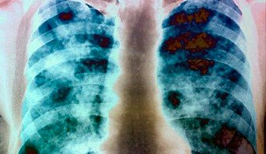
NO CURE FOR SILICOSIS

Slide 42
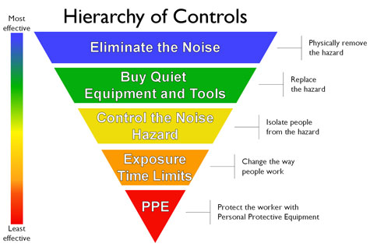
Noise
Noise: Unwanted sound
When noise exposure is too intense or prolonged, may cause harmful effects:
  Temporary or permanent hearing loss
  Fatigue, irritability, tension, circulatory effects
  May not be able to hear warning signals

Slide 43
Noise Rules
Exposure Monitoring
PEL = 90 dBa (General Industry and Construction)
AL = 85 dBA (General Industry Only)
  AL = Action Level.
  When employee's exposure equals or exceeds the AL, employer shall develop and implement a noise-monitoring program
Assess hose noise

Slide 44
Metals
Lead
  Long term exposure may result in damage to your nervous system, reproductive system, kidney and blood forming system
Cadmium
  Long term exposure may result in kidney damage, increased risk of prostate and lung cancer
Inorganic arsenic
  Skin irritant, damage to your nervous system, liver damage, may cause lung cancer

Slide 45
Other Hazards
Media ricochet
Being “shot” by another blaster
Jammed hose
Fall from height
Fatigue
Carbon Monoxide exposure

Slide 46
Getting Organized
Chapter 3

Slide 47
Safety & Health Management System (SHMS)
Construction: Accident Prevention Program (APP) Required
5 primary elements of SHMS
  Management Commitment
  Employee Involvement
  Workplace Analysis
  Hazard Prevention and Control
  Safety and Health Training

Slide 48
Why a SHMS?
Supports organizational philosophy
Communication of H&S goals
Accountability
Long term solutions implemented rather than one-time or short-term fixes
Evaluation over time promotes improvement
Positive bottom line

Slide 49
Getting Started
Create a health and safety vision statement
Place one person in charge
Develop health and safety policy statement
Develop Health and Safety Committee
Get records in place
Appendix VI: MIOSHA Safety and Health Management System

Slide 50
H&S Vision Statement Example
We embrace these five fundamental beliefs:
  The health and safety of people are valued above all else.
  All occupational injuries and illnesses can be prevented.
  Excellence in safety is compatible with excellence in other business parameters such as quality, productivity and profitability; they are mutually supportive. Safe, healthy employees have a positive impact on all operations and customers, and enhance credibility in the community.
  Safety must be made an integral part of everything we do.
  Good Safety is the result of attitudes and beliefs of people. Most injuries and safety incidents occur because of lack of attention to proper engineering controls and work practices.

Slide 51
H&S Policy Statement (Example)
A H&S policy statement should provide a clear indication of the company's objectives and plans for health and safety.

Slide 52
Air Sampling
Chapter 4

Slide 53
Permissible Exposure Limit (PEL)
PEL – Permissible Exposure Limit: CANNOT be exposed to an airborne concentration of respirable crystalline silica in excess of 50 μg/m³, calculated as an 8-hour TWA
Time-weighted average (TWA) means the employee's average airborne exposure in any 8-hour work shift of a 40-hour workweek that shall not be exceeded

Slide 54
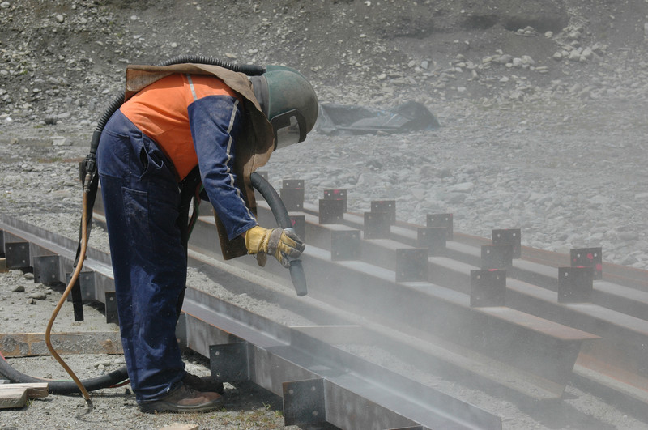
Action Level (AL)
Action level – AL: concentration of airborne respirable crystalline silica of 25 μg/m³, calculated as an 8-hour TWA
https://www.irmi.com/articles/expert-commentary/silica-the-next-environmental-issue

Slide 55
Assess Employee Exposure
When performing abrasive blasting using silica sand or blasting on a silica-containing substrate:
Exposure assessment required when an employee is or may reasonably be expected to be exposed to respirable crystalline silica at or above the action level (25µg/m³)

Slide 56
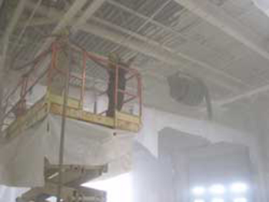
Assess Employee Exposure
2 Options to assess employee exposure:
  Performance Option
  Scheduled Monitoring

Slide 57
Assess Employee Exposure
Performance Option: Assess the 8-hour Time Weighted Average (TWA) using combination of air monitoring data or objective data
  Objective data: air monitoring data from industry-wide surveys
  Calculations based on substance composition and task
  Must reflect workplace conditions closely resembling or with a higher exposure potential

Slide 58
Assess Employee Exposure
Scheduled Monitoring Option:
  Initial Monitoring: Perform 8-hour personal breathing zone air samples that reflect the exposures of employees on each shift, for each job classification, in each work area
    If several employees perform same task in same work area, may sample employee(s) who are expected to have the highest exposure

Slide 59
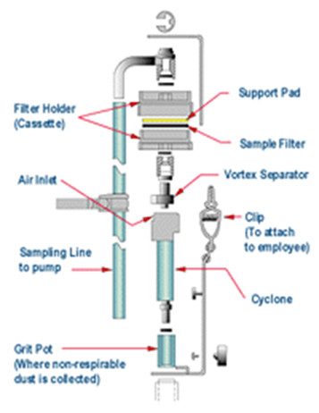
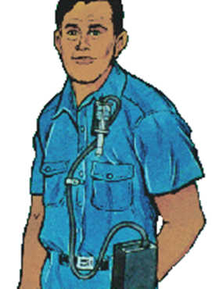
Personal Breathing Zone
Breathing zone samples provide the best indication of the concentration of contaminants in the air the employee is actually breathing.
Cyclone filter assembly and sampling pump
Place filter assembly on worker throughout work shift for up to 8 hours near face (usually within 6-9 inches). Sampling pump usually worn at belt level.

Slide 60
Additional Monitoring
Within 6 months: exposures are ≥ AL (25µg/m³) and ≤ PEL (50µg/m³).
Within 3 months: exposures are > PEL (50µg/m³), repeat monitoring of the most recent monitoring.

Slide 61
Additional Monitoring
Most recent (non-initial) exposure monitoring:
  Exposures < AL (25µg/m³) - repeat monitoring within 6 months of the most recent monitoring until 2 consecutive measurements, taken 7 or more days apart, are < AL
  May discontinue monitoring for employees represented by the monitoring if 2 consecutive measurements, taken 7 or more days apart, are < AL

Slide 62
Additional Monitoring
Employers must reassess exposures whenever:
  Change in the production, process, control equipment, personnel, or work practices may reasonably be expected to result in new or additional exposures ≥ AL
  When employer has any reason to believe that new or additional exposures ≥ AL have occurred

Slide 63
Other Requirements
Employer must ensure that air samples are analyzed by a laboratory meeting the requirements of Appendix A of the Silica standard
Employee notification
  Within 15 working days
  If > PEL (50 µg/m³) – in writing must include corrective action being taken to reduce exposure

Slide 64

Other Requirements
Must keep specific records of air monitoring data and if using objective data, specific records relating to that decision

Slide 65
Specific Air Monitoring Records
The date of measurement for each sample taken;
The task monitored;
Sampling and analytical methods used;
Number, duration, and results of samples taken;
Identity of the laboratory that performed the analysis;
Type of personal protective equipment, such as respirators, worn by the employees monitored; and
Name, social security number, and job classification of all employees represented by the monitoring, indicating which employees were actually monitored.

Slide 66
Specific Objective Data Records
The crystalline silica-containing material in question;
The source of the objective data;
The testing protocol and results of testing;
A description of the process, task, or activity on which the objective data were based; and
Other data relevant to the process, task, activity, material, or exposures on which the objective data were based.
BOTH air monitoring and objective data records must be maintained and made available in accordance with MIOSHA Occupational Health Standard, Part 470 – Employee Medical Records and Trade Secrets

Slide 67
Minimizing Airborne Silica
Chapter 5

Slide 68
Minimizing Airborne Silica
#1: Substitute Alternative Blasting Media
  Aluminum oxide
  Coal slag (watch out for arsenic)
  Steel shot and grit (low toxicity)
  Specular hematite (low toxicity)
  Corn cob
  Garnet
  Glass beads
  Copper slag (watch out for arsenic)

Slide 69
Minimizing Airborne Silica
#2: Engineering Controls
  Substitution (alternative blasting materials, wet abrasive blasting, water jetting, sponge jet blasting, other cleaning techniques)
  Isolation & Containment: barriers, curtain walls, blast rooms, blast cabinets, restricted areas
  Ventilation: Exhaust ventilation
    Exhaust ventilation MUST be maintained to manufacturer specifications to control exposures to below the PEL

Slide 70
Minimizing Airborne Silica
#3: Administrative Controls
  Work Practice: clean using wet methods, Job rotation, written operating procedures, task scheduling
  Personal Hygiene Practices: Prohibit eating/drinking in blasting areas, wash stations, vacuum work clothing before eating/drinking and before leaving for home, etc
  Post Warning signs to mark areas contaminated by silica
Administrative Controls may not control exposures to below the PEL!

Slide 71
Minimizing Airborne Silica
#4: Silica Exposure Control Plan
Must contain:
  Description of tasks in workplace that involve exposure
  Description of the engineering controls, work practices, and respiratory protection used to limit employee exposure
  Description of the housekeeping measures used to limit employee exposure
  Description of procedures used to restrict access to work areas, when necessary, to minimize the number of employees exposed to respirable crystalline silica and their level of exposure, including exposures generated by other employers or sole proprietors

Slide 72
Silica Exposure Control Plan
Construction Employers: designate a competent person to conduct job site inspections and to implement written exposure control plan
  Competent Person: individual capable of identifying existing & foreseeable respirable crystalline silica hazards in the workplace and who has authorization to take prompt corrective measures to eliminate or minimize them

Slide 73
Competent Person - Construction
By way of training and/or experience, a competent person is knowledgeable of applicable standards, is capable of identifying workplace hazards relating to the specific operation, and has the authority to correct them.
There are currently no specific standards regarding competent person requirements.

Slide 74
Regulated Area – General Industry
Silica standard requires GI employers to establish a “regulated area” wherever an employee’s exposure to airborne concentrations of respirable crystalline silica is, or can reasonably be expected to be, in excess of the PEL.

Slide 75
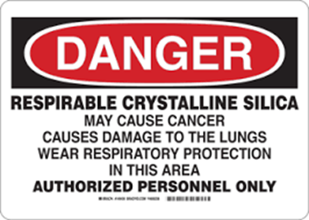
Regulated Area – Required For General Industry Only
Employers shall:
  Demarcate areas from the rest of the workplace in a manner that minimizes the number of employees exposed to silica within the regulated area.
  Post signs at all entrances to regulated areas that bear the following legend
  Limit access to regulated areas to:
    Persons authorized and required by work duties to be present.
    Designated representatives exercising the right to observe
    Any person authorized by the Occupational Safety and Health Act

Slide 76
Regulated Area - Construction
Silica in Construction standard does not have a written requirement to establish a “regulated area”
Should construction employers demarcate, post signage and limit access to areas where silica PEL is exceeded? YES

Slide 77
Respiratory Protection and Personal Protective Equipment
Chapter 6

Slide 78
Personal Protective Equipment
Engineering (substitution, isolation, ventilation) and Work Practice Controls reduces/eliminates the hazard and should be used first!
PPE: Remember…
  PPE does nothing to reduce or eliminate the hazard
  Failure to use correctly means immediate exposure to the hazard

Slide 79
Respiratory Protection
Silica Standard For General Industry (Part 590 ) and Construction (Part 690)
Occupational Health Standard, Respiratory Protection, Part 451
Occupational Health Standard, Abrasive Blasting, Part 523

Slide 80
Respirators MUST BE NIOSH CERTIFIED
All NIOSH-certified respirators have an approval number
  Approval # May or May Not be on the respirator
  May have a separate NIOSH approval label which is found on, or within the packaging

Slide 81
Silica Standard: Respiratory Protection Required
Where exposures exceed the PEL during periods:
  Necessary to install or implement feasible engineering and work practice controls
  When the employee is in a regulated area (General Industry only)

Slide 82
Silica Standard: Respiratory Protection Required
Where exposures exceed the PEL during tasks:
  Certain maintenance and repair tasks, for which engineering and work practice controls are not feasible
  For which an employer has implemented all feasible engineering and work practice controls and such controls are not sufficient to reduce exposures to or below the PEL

Slide 83
Abrasive Blasting (Part 523)
Only approved respirators may be used
Employees must wear abrasive-blasting respirators when:
  Working inside blast-cleaning rooms
  Using silica sand in manual blasting operations where operator is not physically separated from blasting operation
  When above PEL and operator not physically separated from blasting operation
Employees should wear respirators:
  During clean-up operations

Slide 84
Abrasive Blasting Respirators
Type CE: supplied air respirator equipped with additional devices designed to protect the wearer’s head and neck against impact and abrasion from rebounding abrasive material, has shielding material to protect the window, shielding material does not obstruct vision and permits easy access to clean window

Slide 85
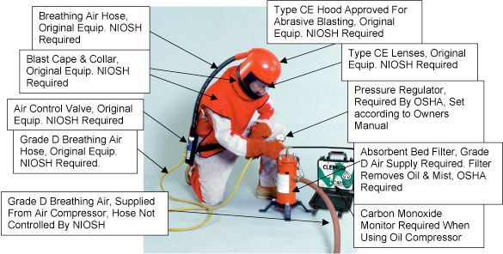
Type CE Respirator Components
http://www.clemcoindustries.com/safety_showitem.php?item_id=11112

Slide 86
Respirator Terminology
Assigned Protection Factor (APF):
  The workplace level of respiratory protection that a respirator or class of respirators is expected to provide to employees when the employer implements a continuing, effective respiratory protection program
Maximum Use Concentration (MUC):
  The maximum atmospheric concentration of a hazardous substance from which an employee can be expected to be protected when wearing a respirator, and is determined by the APF of the respirator or class of respirators and the exposure limit of the hazardous substance.

Slide 87
Respirator Terminology
Maximum Use Concentration (MUC): Math Equation
  APF x Exposure Limit = MUC
  When no MIOSHA exposure limit is available for a hazardous substance, an employer must determine an MUC on the basis of relevant available information and informed professional judgment.

Slide 88
NIOSH Approved Abrasive Blasting Respirators
Continuous flow, loose hood, APF = 25
Continuous flow, tight-fitting facepiece, APF = 50
Positive Pressure, tight-fitting half-mask facepiece, APF = 1000
Pressure demand or positive pressure, tight-fitting full face piece, APF = 2000
Respirator User Notice May 23, 1996

Slide 89
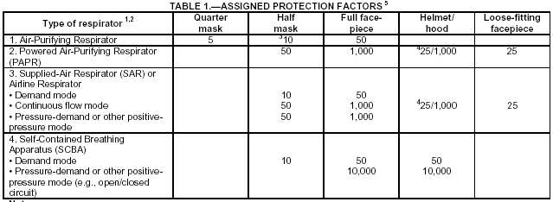
Respirator APF 1910.134(d)(3)(1)(A)
See Handout

Slide 90
Respirator – Medical Exams
Consists of medical questionnaire
Physician or licensed health care professional (PLHCP) reviews questionnaire, recommends follow-up examination if medically necessary
  Frequency is at the discretion of the PLHCP.
  Factors that can change frequency include change in job tasks, type of respirator and/or individual having medical issues when using.

Slide 91
Medical Evaluations
Required:
  When wear any type or respirator
  Prior to respirator fit test and before first use
PLHCP determines:
  Whether individual is medically able to wear the respirator
  Tests in the follow-up medical exam (as needed)
  Restrictions

Slide 92
Respirator Fit Testing
Fit testing is required for all negative or positive pressure tight-fitting face piece respirators
  Different sizes and models
  Pick size/model to fit person’s face
  Required annually when a respirator is required to be worn
Type CE abrasive blasting respirators that are loose-fitting (hoods, helmets) DO NOT need to be fit tested
Types of fit tests:
  Qualitative
  Quantitative

Slide 93
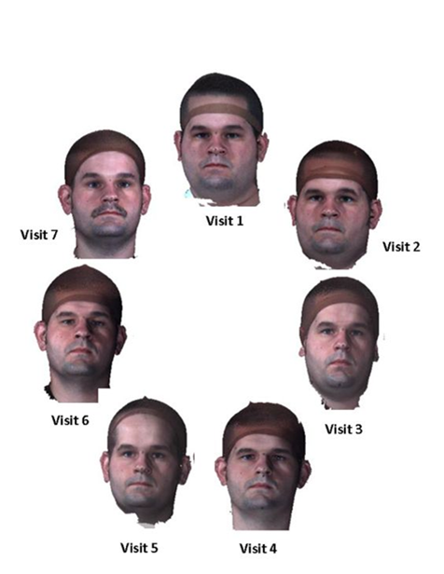
Why Fit Test? NIOSH Research
3-year study: 10% of subjects failed a fit test after 1 year, 20% after 2 years, 26% after 3 years using the same make, model and size respirator
24% of subjects who lost ± 20lbs no longer maintained an acceptable fit
  Facial changes requiring fit testing: extensive dental work, scarring, aging, cosmetic surgery.
Other factors:
  Improper storage and maintenance of respirator
  Respirator straps losing their elasticity

Slide 94
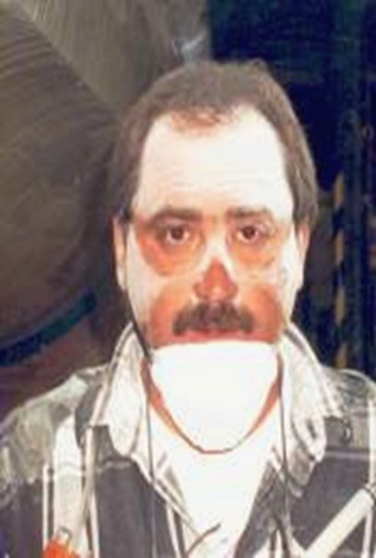
The Importance of Fit
Respirator fit is important because it involves several major issues:
  Seal
  Compatibility with other PPE
  Stability

Slide 95
Fit Test Protocol
Individual wears respirator
Series of exercises
Test atmosphere
Recommended Protocol – Appendix A of the Respiratory Protection Standard

Slide 96
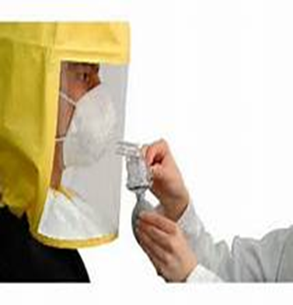
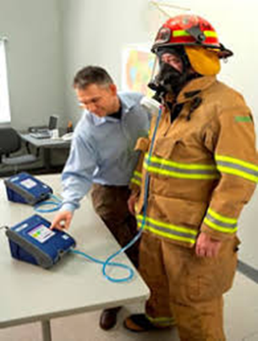
Types of Fit Tests
Qualitative
  Test agent directed around head of the respirator wearer
  Subjective test: If user can detect agent, test failed
Quantitative
  Test atmosphere
  Quantifies respirator fit using instrumentation to determine the amount of leakage into the respirator face piece

Slide 97
Fit Tests
Qualitative Fit Test
  Banana oil
  Irritant smoke
  Saccharin challenge
  Bitrex solution
Quantitative Fit Test
  Expensive machinery
  Fit factors
    Outside air concentration compared to inside the respirator air concentration
Standard prohibits facial hair which interferes with face - to – face piece seal or valve function

Slide 98
User Seal Checks
Assures a proper fit
Face to face piece seal
Recommended protocols in Appendix B-1 of Respirator standard
User Seal Check
  Positive Pressure Check
  Negative Pressure Check
NOT a substitute for Fit Tests!

Slide 99


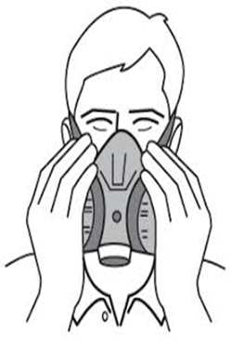
User Seal Check vs. Fit Test
Qualitative Fit Test
Negative & Positive
Pressure User Seal Checks

Slide 100
Respirator Maintenance & Care (Appendix B-2 of 1910.134)
Clean and disinfect as often as necessary to maintain a sanitary condition
Inspect before and after each use and after cleaning
Store away from heat, cold, light, moisture, dusts and chemicals
Store respirator in a clean area/plastic bag not in work exposed area

Slide 101

Written Respiratory Protection Program
Must have trained program administrator
  Respirator selection
  Medical evaluation
  Fit testing
  Proper use (emergency
  Maintenance program
  Respirator air supply monitoring
  Employee training
    Respiratory hazards
    Proper use of respirator
  Program evaluation
https://www.soph.uab.edu/DSC/respiratory-protection-program

Slide 102
Compressors
Locate so contaminated air cannot enter
Low moisture content
Inline air-purifying sorbent bed & filter maintained
Tag showing maintenance kept at compressor
Pressure reducing valve

Slide 103
Compressors
Oil Lubricated:
  Alarm for overheating
  Carbon Monoxide monitor
  or both
Non oil lubricated:
  Assure carbon monoxide not more than 10 ppm

Slide 104
Personal Protective Equipment
Hazard Assessment
  Selection
  Communication
  Fit
Safe, reliable, sanitary
Clean, inspect and maintain
MUST NOT use defective or damaged PPE

Slide 105
Hazard Assessment
Written Certification Required (General Industry only)
  Assess workplace for hazards
  Certifier
  Date of workplace hazard assessment
Construction: employer shall require each employee to wear PPE according to manufacturer and where there is an exposure to hazardous conditions or are required to wear by health/safety standard(s)

Slide 106
PPE for Abrasive Blasters
Disposable or washable work clothes (abrasive blasting suit as appropriate)
Heavy canvas or leather gloves (with gauntlets as appropriate)
Heavy canvas or leather apron
Protective head, neck and shoulder gear
Safety shoes/boots
Hearing protection (if needed)
Supplied air respirator

Slide 107
Protective Clothing
Employee: DO NOT take home! Leave at worksite!
Employer should launder or dispose of clothing

Slide 108
Hearing Protection

Slide 109
Hearing Protection
Selection (formable plugs, pre-molded plugs, earmuffs)
Noise Reduction Rating (NRR)
  Amount of decibels that a given device will reduce noise exposure in a laboratory test
  For most wearers, the NRR significantly overestimates the protection of the hearing protector in the workplace

Slide 110
Using the Noise Reduction Rating
Protected dBA = Unprotected dBA-[NRR-7]
Example:
Unprotected Workplace Exposure dBA = 95
Ear Protection NRR = 19
Protected dBA: 95- [19-7] = 95 – [12]
Protected dBA = 83

Slide 111
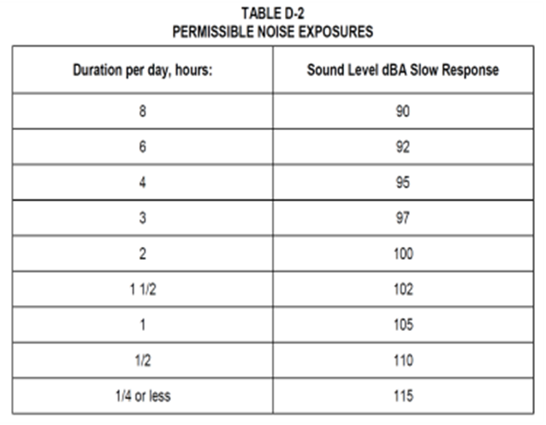
Hearing Conservation Program
Construction
  Required if sound levels exceed values shown in Table D2 of MIOSHA Part 680
  No specific program elements required by Part 680
    Recommend incorporating General Industry hearing conservation requirements

Slide 112
Hearing Conservation Program
General Industry
  Required if sound levels exceed 85 dBA (Action Level)
  Program elements
    Noise exposure monitoring
    Noise control process
    Hearing protection
    Education and notification
    Audiometric evaluation
    Recordkeeping
Remember:
Part 380 (Noise Standard) must be posted if hearing conservation program required

Slide 113
Safety Training
Chapter 7

Slide 114
Silica Standard
Health hazards of exposure
Specific tasks in workplace = exposure
Employer protective measures
Contents of education and training section of silica standard
Purpose and description of medical surveillance program

Slide 115
Respirator Training
Annual training (and retraining when required)
Topics
  Why respirator is necessary
  How improper fit, usage or maintenance may compromise the protective effect
  Use in emergency including situations where respirator malfunctions
  Limits/capabilities of respirator
  Maintenance and storage
  How to inspect, put on, remove, use and check seals of respirator
  How to recognize medical signs & symptoms that may limit/prevent effective use of the respirator
  General requirements of respirator standard

Slide 116
Hazard Communication
Training must be performed at time of their initial assignment, and whenever a new chemical hazard the employees have not previously been trained about is introduced into their work area
Topics
  Operations in work area where hazardous chemicals are present
  Location/availability of written hazard communication program
  Methods/observations used to detect presence of hazardous chemical
  Chemical hazards
  Protective measures workers can take (PPE, work practices, etc.)
  Details of employer’s written program including:
    Labels
    Safety data sheets, including the order of information and how employees can obtain and use the appropriate hazard information

Slide 117
Personal Protective Equipment
Construction
No specific training requirement in Construction PPE standard, Part 6
Part 6 does require: An employer shall require each employee to wear personal protective equipment as prescribed by the manufacturer when required by any Michigan occupational safety and health act (MIOSHA) rule.

Slide 118
Personal Protective Equipment
General Industry
Topics
  When, why and what personal protective equipment is necessary
  How to wear
  Limitations
  Care and maintenance
  Disposal
  Certify with:
    Employee’s name
    Date of training
    Subject of training

Slide 119
Noise (General Industry)
Effects of noise
Noise controls in workplace
Purpose of hearing protection
Instructions on hearing protection use
Purpose and procedures of audiometric testing

Slide 120
NOISE (Construction)
If a hearing conservation program is required to be implemented:
Recommended Topics
  Effects of noise on hearing,
  Work activities requiring hearing protection
  Purpose of hearing protection, t
  Advantages, disadvantages and attenuation of various types of hearing protection,
  Selection, fitting, use and care of hearing protectors

Slide 121
Medical Records/Trade Secrets
Initial and annual training
Existence, location and availability of any record to which the rule applies
Person responsible for maintaining and providing access
Employee’s right of access to records

Slide 122
Cleaning Up
Chapter 8

Slide 123
Housekeeping
Minimize dust exposure
  Wet methods, HEPA-filter vacuum, sweeping compounds, other dust suppression
Prohibited: compressed air, dry sweeping, dry brushing (unless above methods not feasible)
  Employer bears burden showing why wet methods, HEPA, dust suppression infeasible

Slide 124
Why Do I Need a HEPA-Filter Vacuum
High Efficiency Particulate Air (HEPA)
Air filter removes from the air that passes through it: 99.97% of particles that have a size greater than or equal to 0.3 µm
Remember!
  Respirable dust: <10µm diameter
  Respirable silica that causes silicosis: 0.2-5µm

Slide 125
Personal Hygiene
Vacuum clothing using a HEPA vacuum
Shower after work
Wash hands & face before eating, drinking or smoking
No food, drink or tobacco in blast area – set up separate eating space
Park cars downwind and/or away from area
Wear Disposable Clothing

Slide 126
Remember: Silica on your work clothes and body becomes silica in your vehicle and then silica exposure for your family

Slide 127
Medical Monitoring
Chapter 9

Slide 128
Medical Surveillance
Required by silica standard
Reasons for medical surveillance
  ID silica-related disease
  Determine if employee may have pre-existing condition which may make employee more sensitive to silica exposure
  Ability to wear a respirator
Remember: medical surveillance is not a substitute for good dust control in the workplace

Slide 129
Medical Surveillance: Construction
Required to wear respirator 30 or more days/year
  Wearing a respirator anytime during the day counts as one day
Employer must estimate how often respirator will be used
If estimate was <30 days and looks like employee will wear the respirator 30+ days, make medical surveillance available

Slide 130
Medical Surveillance – General Industry
Employees who will be exposed above the PEL for 30 or more days/year
June 23, 2020: Employees who will be exposed above the AL for 30 or more days/year

Slide 131
Frequency of Medical Exams
Initial exam: within 30 days of assignment
Periodic exam: At least every 3 years from last exam OR more frequently if recommended by PLHCP

Slide 132
Medical Exam Tests
In-depth medical and work history (past, present, anticipated – silica exposures, other respiratory agents, respiratory dysfunction, TB and smoking history)
Physical exam – special emphasis on the respiratory system
Chest x-rays – specific requirements see standard
Pulmonary function test (spirometry)
Testing for latent TB infection (initial exam only)
  blood or skin test
Any other tests deemed appropriate by the PLHCP

Slide 133
Chest X-Rays
All chest x-rays must be interpreted by a licensed doctor who is specially certified by the federal government to review the x-ray. These doctors are called B readers. The list of all B readers in Michigan and the rest of the country can be found:
https://wwwn.cdc.gov/niosh-rhd/cwhsp/ReaderList.aspx

Slide 134
Employers Must Provide to PLHCP
Ensure PLHCP has copy of relevant silica standard
Description of employee’s former, current, future duties related to silica exposures
Employee's former, current, and anticipated levels of occupational exposure to respirable crystalline silica
Description of PPE used or to be used, including when and how long it is used
Information from records of employment-related medical exams previously provided to employee if possible (within the control of the employer)

Slide 135
PLHCP Must
Write a medical report
  PLHCP must explain written medical report to the employee
  Provide the medical report to employee within 30 days (employer does not receive a copy)

Slide 136
Written Medical Report from PLHCP to Employee
A statement indicating the results of the medical exam, any medical conditions that would place the employee at increased risk of material impairment to health from silica and any conditions that require further evaluation or treatment
  Reportable Condition: 1/0 on chest film
Any recommended limitations on the employee’s use of respirators

Slide 137
Written Medical Report from PLHCP to Employee
Any recommended limitations on the employee’s exposure to silica
A statement that the employee should be examined by a specialist if the chest X-rays is classified as 1/0 or higher by the B Reader, or if a referral to a specialist is otherwise deemed appropriate by the PLHCP

Slide 138
Employer Receives from PLHCP
Written medical opinion within 30 days of the medical examination. The written opinion shall contain only the following:
  Date of the exam
  A statement that the exam has met the requirements of this section
  Any recommended limitations on the employee’s use of respirators

Slide 139
Employer Receives from PLHCP
If employee provides written authorization, written opinion shall also contain either or both of the following:
  Any recommended limitations on the employee’s exposure to silica
  A statement that the employee should be examined by a specialist regarding X-ray results or other specialist deemed appropriate

Slide 140
Employer Must Give to Employee
The employer shall ensure that each employee receives a copy of the written medical opinion for the employer within 30 days of the exam

Slide 141
Keeping Family Safe
Chapter 10

Slide 142
Keeping Family Safe
Don’t take silica dust home!
Air regulations keep communities from inhaling respirable crystalline silica from abrasive blasting activities
Water regulations and proper waste disposal minimizes exposure for animal and people to other heavy metal exposure from waste products resulting from abrasive blasting

Slide 143
Remember: Silica on your work clothes and body becomes silica in your vehicle and then silica exposure for your family

Slide 144
Summary
Only You Can Keep your Family Safe - Don't Bring Silica Home

Slide 145
What Precautions Can Reduce the Risk?
Substitute alternative blasting medias
Maintain dust control systems
Blast in automatic balst cleaning machines or cabinets
Conduct air monitoring
Use proper respiratory protection

Slide 146
What Precautions Can Reduce the Risk?
Worker training
Practice good personal hygiene
Wear disposable clothing
Shower/change clothes
No food, drink, tobacco in blast areas
Provide medical monitoring
Post warning signs to mark contaminated areas

Slide 147



Awareness Planning
Communication
Prevent Silicosis

